Slide 1
Pythagorean Theorem proof from similar right triangles
A geometric realization of a proof in H. Wu’s “Teaching Geometry According to the Common Core Standards”

Slide 2
Given a right triangle ΔABC with legs a and b and hypotenuse c.
Prove a² + b² = c²
A
c
b
C
a
B

Slide 3
In other words, prove that the sum of the areas of the squares on the legs a and b
c²
A
c
is equal to
the area of
the square on
the hypotenuse c.
b²
b
C
a
B
a²

Slide 4
But how can we possibly prove that
is equal to
the sum of the areas of these
the area of this?
c²
a²
?
b²
We don’t have to prove that the figures are equal—they aren’t! All we have to do is prove that the area of the two little squares equals the area of the big square.

Slide 5
Maybe if we could partition the big square into 2 rectangles, one equal in area to a², and the other to b²…
c²
a²
b²
Hang onto that dream as we proceed…

Slide 6
We’ll partition ΔABC into 3 similar right triangles and use the equal ratios of their corresponding parts in our proof.
Draw a perpendicular
to the hypotenuse AB
through the vertex of the right angle at C.
A
c
D
b
C
a
B
That perpendicular intersects AB at a point we’ll call D.

Slide 7
Now we have 3 similar right triangles:
ΔABC, the big one we started with, containing ∠A and ∠B,
A
c
D
ΔACD, the little one that contains ∠A,
b
C
a
B
and ΔBCD, the other little one that contains ∠B.

Slide 8
We know all 3 triangles are similar by AA: two pairs of equal corresponding angles make similar triangles.
A
c
Each triangle has a right angle, and all right angles are equal.
D
b
C
a
B
And each triangle contains either ∠A or ∠B or both.

Slide 9
Reflection, translation, and rotation enable a nice arrangement of our 3 similar triangles.
A
C
D
A
a
b
b
D
C
C
a
B
D
B
A reflection across AC
A reflection across DB
A translation
A translation
Then a rotation
Then a rotation

Slide 10
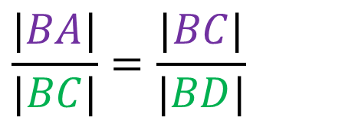
Similar triangles means that the ratios of their corresponding parts will be equal.
A
c
C
D
A
a
b
b
D
C
C
a
B
D
B
ΔABC
∼
ΔCBD
⇒
$$\frac{hypotenuse}{long leg}=\frac{hypotenuse}{long leg}$$
$$\frac{|BA|}{|BC|}=\frac{|BC|}{|BD|}$$
⇒
Notes:
ΔABC ∼ ΔCBD

Slide 11
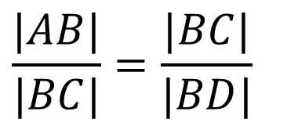
By the cross-multiplication algorithm…
A
c
C
D
A
a
b
b
D
C
C
a
B
D
B
$$\frac{|AB|}{|BC|}=\frac{|BC|}{|BD|}$$
⇒
${|BC|}^{2}=\left|AB\right|∙$ $|BD|$
$$substituting$$
⇒
$a^{2}= c∙$ $|BD|$

Slide 12
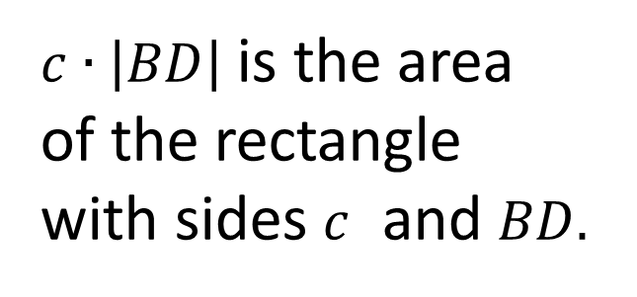
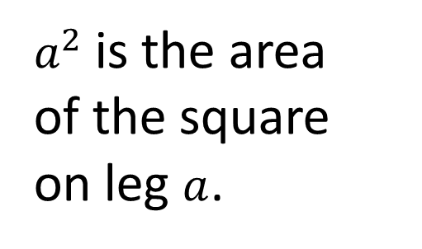
Now we have
$a^{2}= c∙$ $|BD|$
$c∙$ $\left|BD\right|$
A
D
c
$a^{2}$ is the area of the square on leg $a$.
C
a
B
a²
$c∙$ $\left|BD\right|$ is the area of the rectangle with sides $c$ and $BD.$

Slide 13
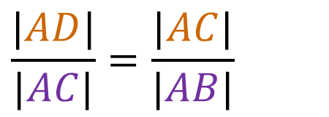
Looking at the left triangles, similarity gives us
A
c
C
D
A
a
b
b
D
C
C
a
B
D
B
ΔACD
∼
ΔABC
⇒
$$\frac{short leg}{hypotenuse}=\frac{short leg}{hypotenuse}$$
$$\frac{|AD|}{|AC|}=\frac{|AC|}{|AB|}$$
⇒

Slide 14
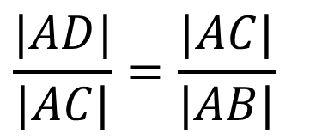
By the cross-multiplication algorithm, we have
A
c
C
D
A
a
b
b
D
C
C
a
B
D
B
$$\frac{|AD|}{|AC|}=\frac{|AC|}{|AB|}$$
⇒
${|AC|}^{2}=\left|AB\right|∙$ $|AD|$
$$substituting$$
⇒
$b^{2}= c∙$ $|AD|$

Slide 15
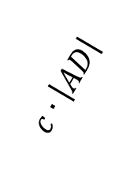
And now we have
Could this be the partition we had been dreaming of?
c
$b^{2}= c∙$ $\left|AD\right|$
$c∙$ $\left|AD\right|$
A
D
b²
b
C
a
B
$b^{2}$ is the area of the square on leg $b$.
$c∙$ $\left|AD\right|$ is the area of the rectangle with sides $c$ and $AD.$

Slide 16
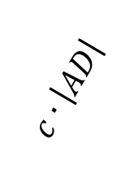
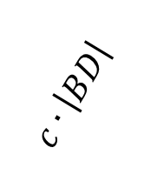
Putting it together…
c
$a^{2}= c ∙$ $|BD|$
$c∙$ $\left|AD\right|$
$c∙$ $\left|BD\right|$
$b^{2}= c ∙$ $|AD|$
A
c
D
c
b²
b
C
a
B
Adding, we get
$$a^{2}+ b^{2}$$
$= c∙\left|BD\right|$ $+ c∙|AD|$
a²
Notes:
That line through C, perpendicular to the hypotenuse AB, does indeed partition the square on c into two rectangles, one equal to $a^{2}$ and the other equal to $b^{2}$.

Slide 17
Since $a^{2}+ b^{2}=$
$$c∙\left|BD\right|$$
$$+ c∙|AD|$$
We distribute out $c$and get
$c∙$ $\left|AD\right|$
$a^{2}+ b^{2}$
$$=c∙(\left|BD\right|+\left|AD\right|)$$
c²
$c∙$ $\left|BD\right|$
A
c
We notice that $c=\left|BD\right|+\left|AD\right|$
D
c
$$c$$
b²
b
so we substitute for $\left|BD\right|+\left|AD\right|$, giving us
C
a
B
a²
$a^{2}+ b^{2}$
$$=c∙(c)$$
and finally
$$a^{2}+ b^{2}= c^{2}$$

